Slide 1
X Education - Lead Scoring Case Study
Increasing lead conversion rate for X education
Group Members:
Prasoon
Mayukh Das
Cyril Philip

Slide 2
Background
X Education , An education company sells online courses to industry professionals.
Many interested professionals land on their website.
The company markets its courses on several websites like Google. Once these people land on the website, they might browse the courses or fill up a form for the course or watch relevant videos.
When these people fill up a form providing their email address or phone number, they are classified as a lead.
Once these leads are acquired, employees from the sales team start making calls, writing emails, etc. Through this process, some of the leads get converted while most do not.
The typical lead conversion rate at X education is around 30%.
X Education Company

Slide 3
Problem Statement
X Education gets a lot of leads but its lead conversion rate is very poor.
To make this process more efficient, the company wishes to identify the most potential lead, also known as ‘Hot Leads’.
If they successfully identify this set of leads, the lead conversion rate should go up as the sales team will now be focusing more on communicating with the potential leads rather than making calls to everyone.
We will help them select the most promising leads, i.e. the leads that are most likely to convert into paying customers.
We are required to build a model wherein we need to assign a lead score to each of the leads such that the customers with higher lead score have a higher conversion chance.
The CEO, in particular, has given a ballpark of the target lead conversion rate to be 80%.
X Education Company’s Problem

Slide 4
Solution
For the Solution to the mentioned problem, the crucial part is to accurately identify hot leads.
Higher Conversions seem directly proportional to the accuracy in obtaining the hot leads
Hence, high number of hot leads are required in order to fulfill the criteria of 80% conversion rate.
Finding Hot Leads accurately

Slide 5
EDA- Visualization

Slide 6
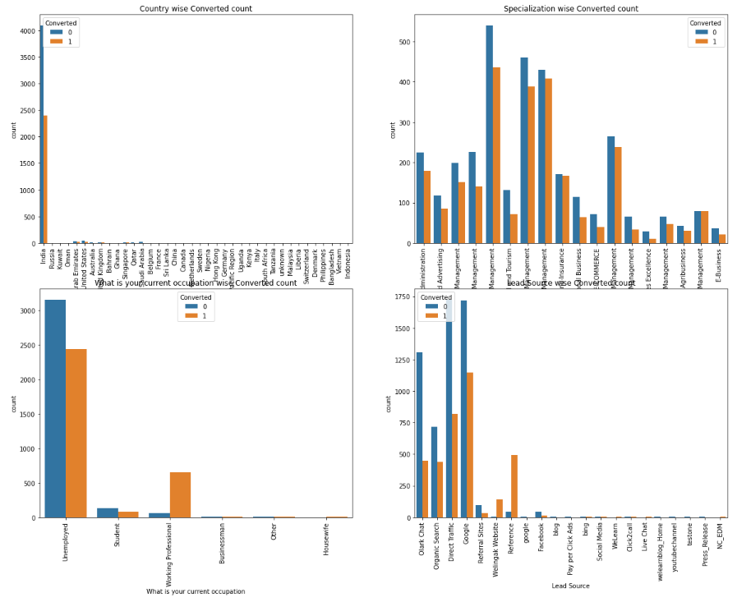
India is the top source of ‘student’ and target ‘working professional’ or ‘unemployed’.

Slide 7
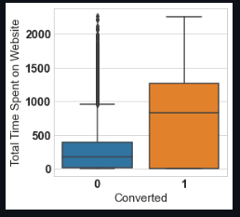
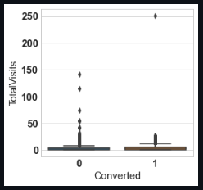
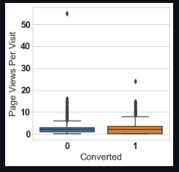
EDA plots depicting variation in ‘Time spent’, ‘Total visits’ and ‘Views per visit’ columns for Converted and Not-Converted.

Slide 8
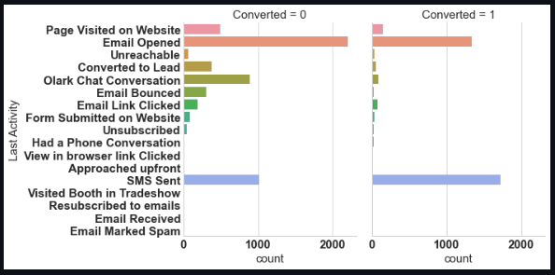
EDA plots depicting variation ‘Last Activity’ column for Converted and Not-Converted.

Slide 9
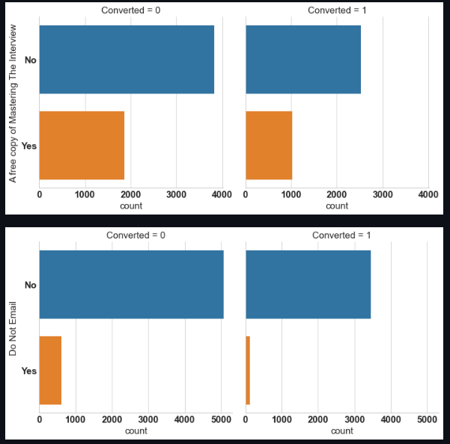
Variation in columns ‘A free copy of Mastering The Interview’ and ‘Do not email’ for Converted and Not-Converted.

Slide 10
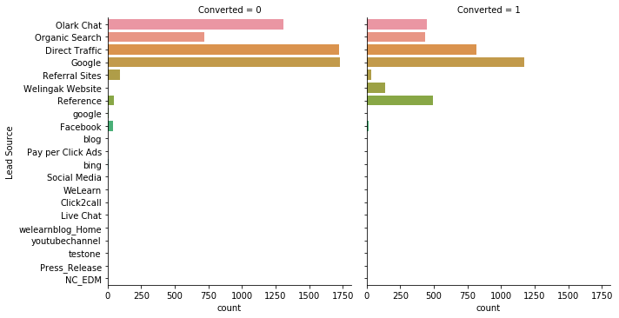
Visualization plots showing the variation in column ‘Lead Source’ for Converted and Not-Converted.

Slide 11
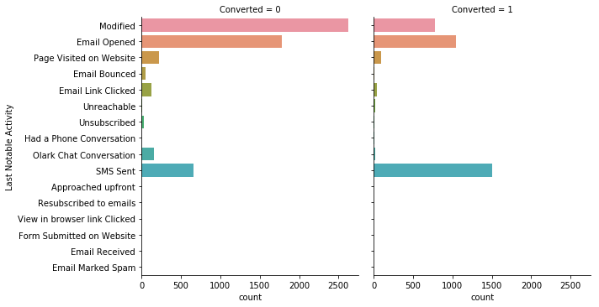
Visualization plots showing variation in column ‘Last Notable Activity’ for those Converted and Not-Converted.

Slide 12
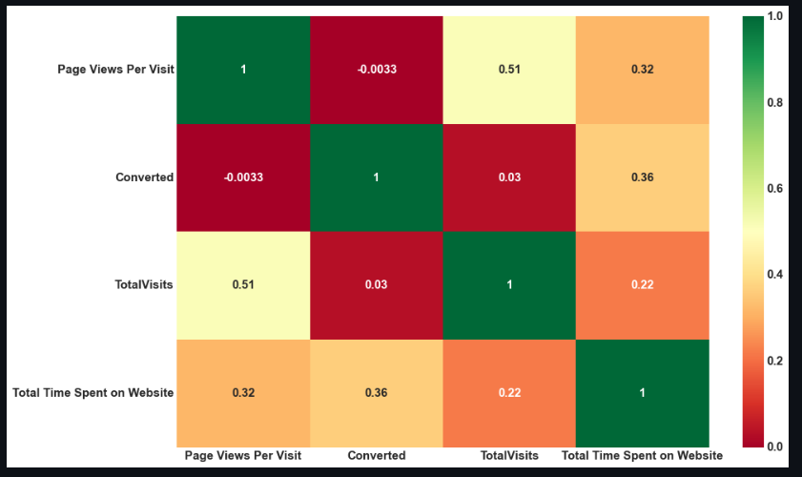
‘Heat Map’ for all finally selected numerical columns after EDA.

Slide 13
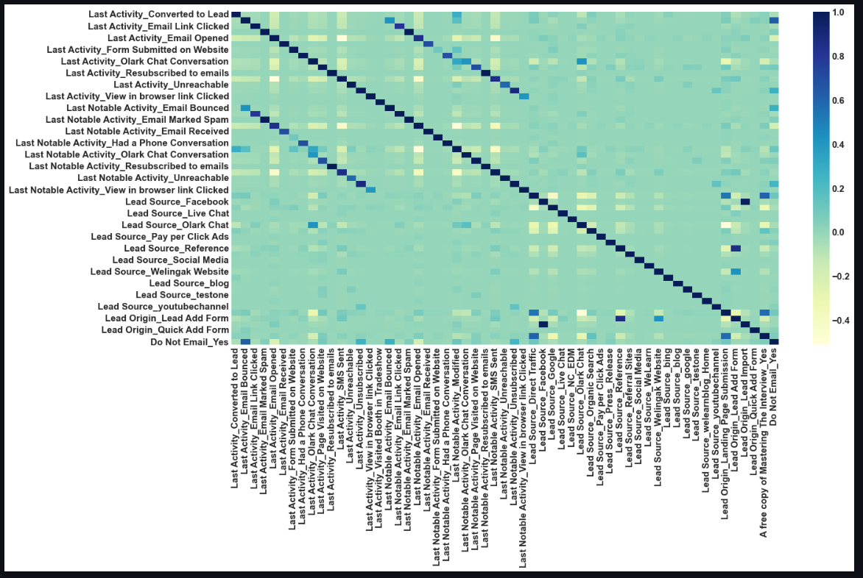
‘Heat Map’ for all selected columns (numerical as well as dummy columns).

Slide 14
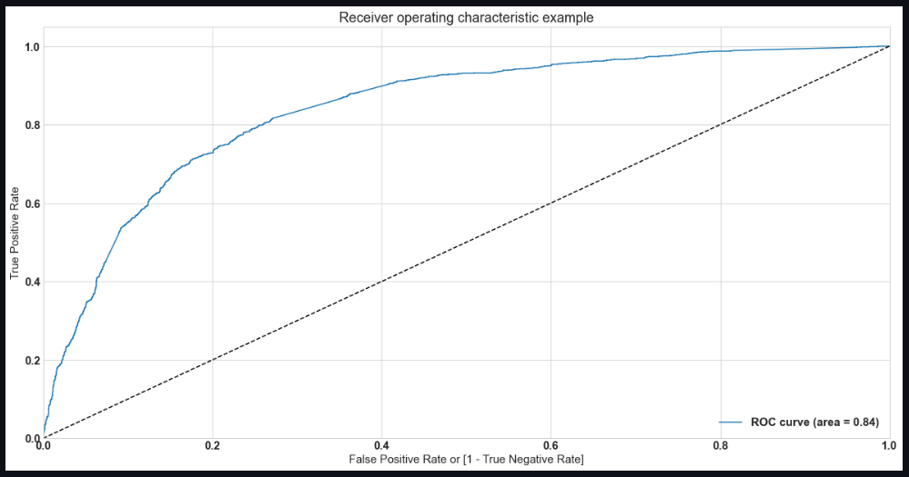
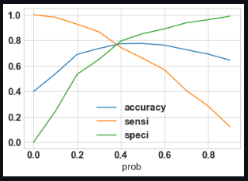
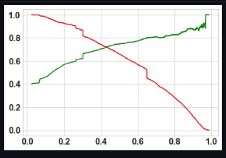
Linear Regression Final Model Parameters
Area under ROC = 0.84
Intermediate cut-off = 0.35
Final cut-off = 0.42

Slide 15
Inference / Conclusion

Slide 16
Model Analysis
Overall accuracy on Test set: 0.76
Sensitivity for the logistic regression model: 0.73
Specificity for the logistic regression model: 0.81
Performance of Final Model

Slide 17
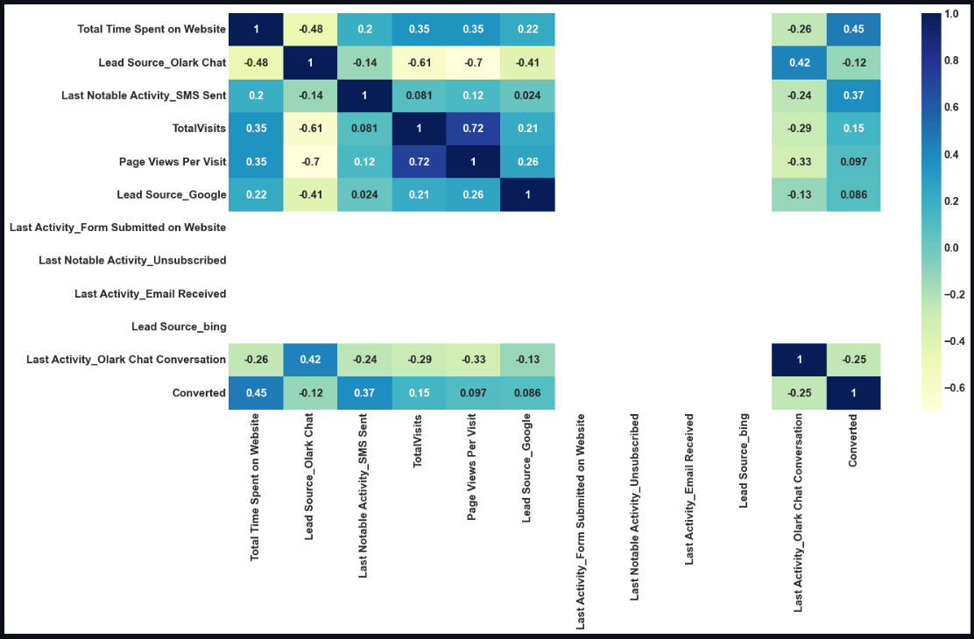
Correlation Between Model selected indicators

Slide 18
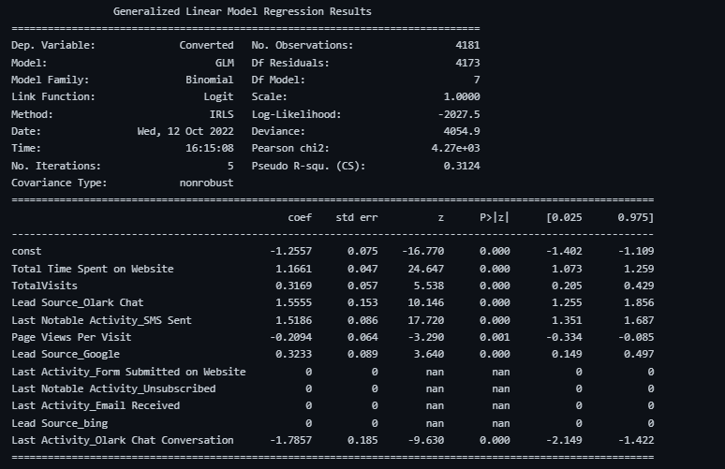
Relevant stats

Slide 19
Conclusion (Recommendation)
X Education Company needs to work on below mentioned key aspects in order to improve the overall conversions:
Look for ways to increase user engagement on the website in order to have higher conversions.
Get Total visits increased by advertising etc.
SMS notifications seems an effective way to increase conversions.
Olark Chat service has to be improved as this seems helpful.

Slide 20
Thank-you

